Slide 1
Predicting Heart Disease Using Supervised Learning
November 17, 2019

Slide 2
Road Map
Motivation
Results
Method
  Exploratory Data analysis
  Data Preparation
  Modelling, Classification and Evaluation
Conclusion and next steps

Slide 3
Motivation
1:4
Deaths are caused by heart disease annually
735,000
People have heart disease every year
Source: Center for Disease Control and Prevention
Heart disease is one of the major causes of death globally. Reliable and accurate detection of heart disease is one of the crucial steps in stopping preventable deaths caused by heart disease. With the advent of data science tools, there are many methods that can advance early detection and prognosis of cardiovascular diseases.
Advancements in heart disease detection relying on indicators that are statistically determined to play a significant role in heart disease related deaths could save lives.
Notes:
Heart disease is the number one cause of death worldwide, so if you're looking to use data science for good you've come to the right place. To learn how to prevent heart disease we must first learn to reliably detect it.
Our dataset is from a study of heart disease that has been open to the public for many years. The study collects various measurements on patient health and cardiovascular statistics, and of course makes patient identities anonymous.

Slide 4
Data set
Data Title: Predicting Heart Disease
Data Source: Cleveland Heart Disease Database via the UCI Machine Learning repository
Shape: (180 x 15)
Outcome Variable : Heart Disease Present
Features to be dropped : patient_id
Notes:
Advantages of the dataset, pretty clean, no null values

Slide 5
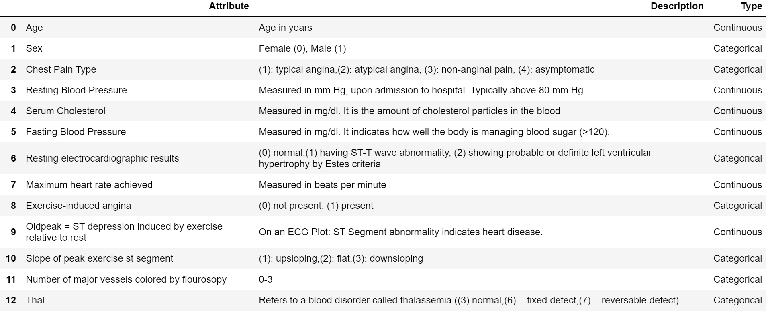
Features

Slide 6
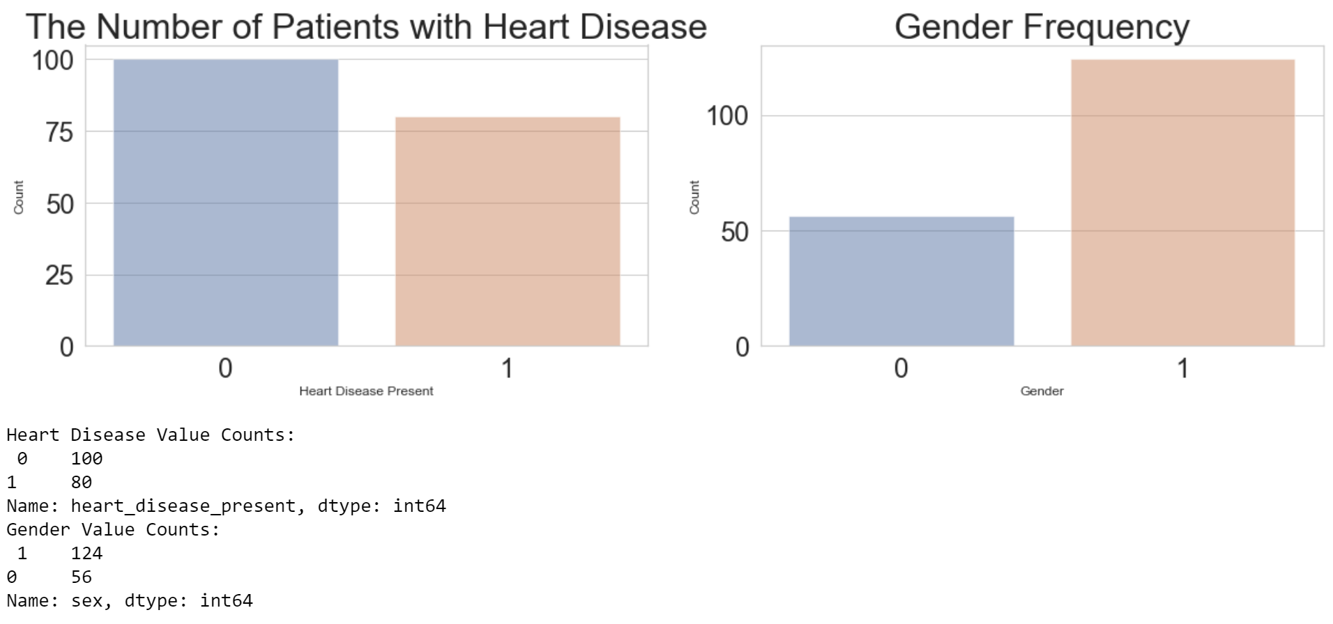
Method: Data Exploration
Heart disease present
Female
Heart disease not present
Male
Notes:
Right off the bat, we can see that imbalance is not really an issue for this dataset in terms of patients with heart disease versus those without it. We also see that males that there are more males than females in the dataset, almost double.

Slide 7
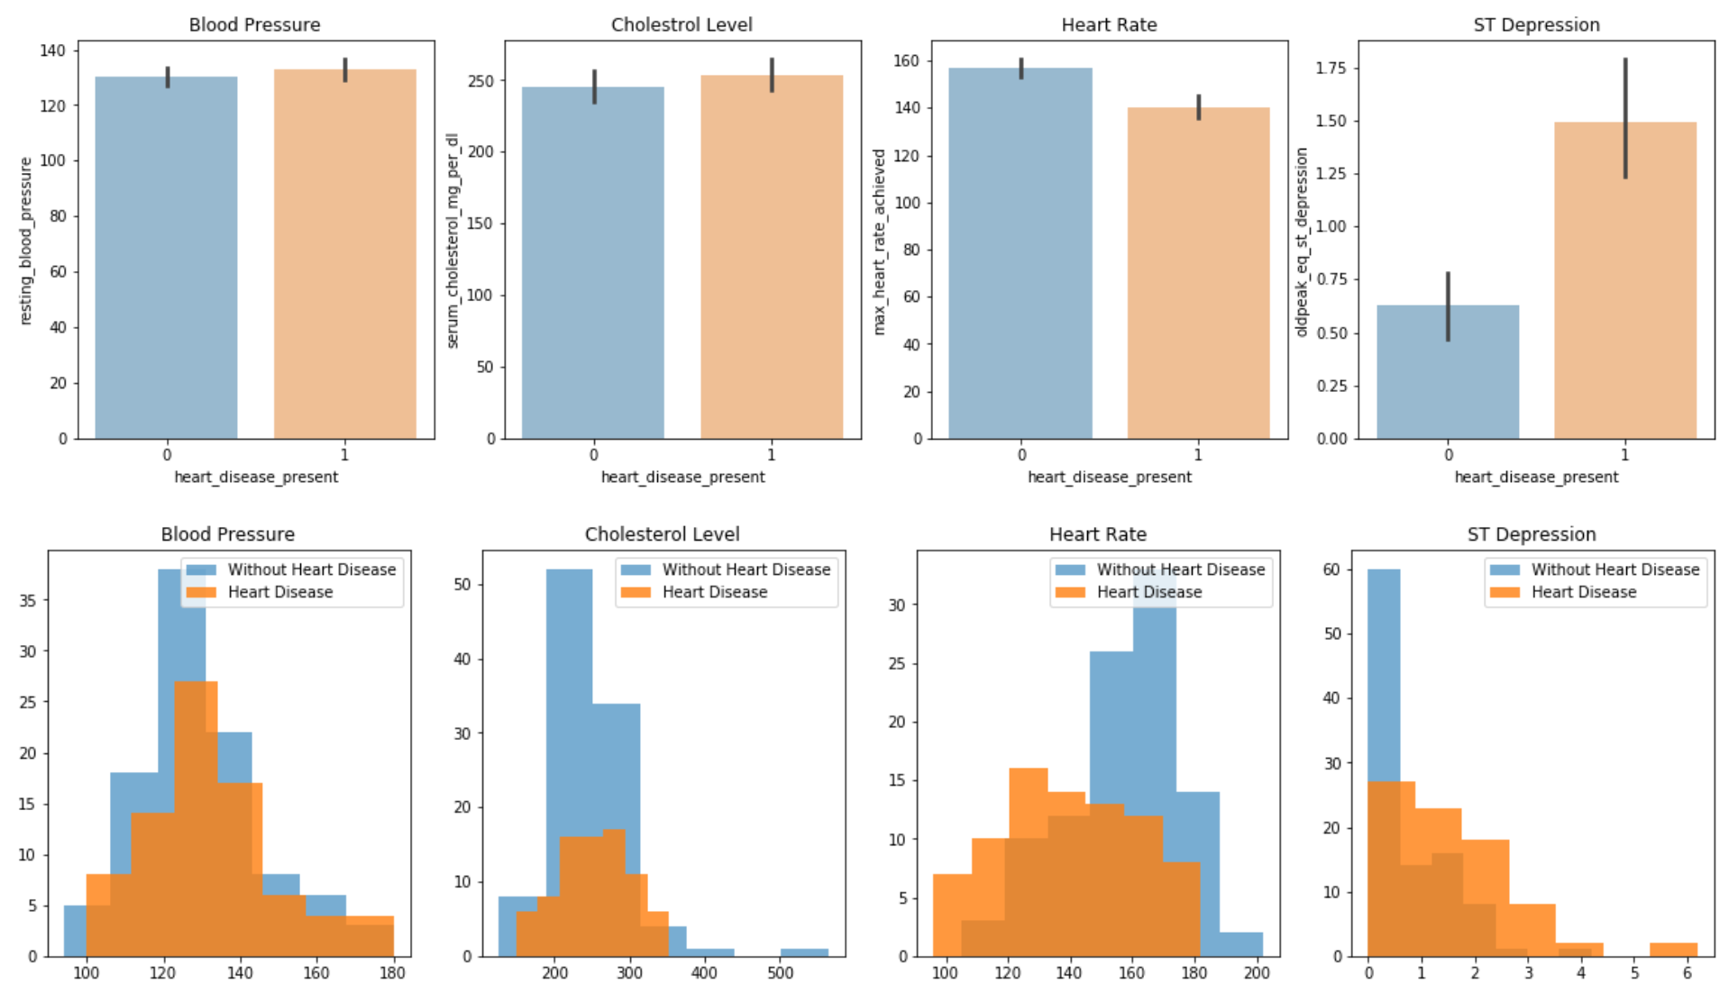
Method: Data Exploration
Heart disease present
Heart disease not present
Notes:
For features blood pressure, cholesterol level and heart rate, the data is more or less balanced between heart disease present and not, and in terms of distribution the data closely resembles normal distribution.
For ST Depression, which indicates abnormality in electrodiagrams, the frequency chart indicates correlation and the distribution is skewed to the left.
Based on a T-Test conducted, the results shows that there is a significant difference between groups with and without heart disease for the features Max Heart Rate Achieved and ST Depression.
oldpeak = ST depression induced by exercise relative to rest, a measure of abnormality in electrocardiograms

Slide 8
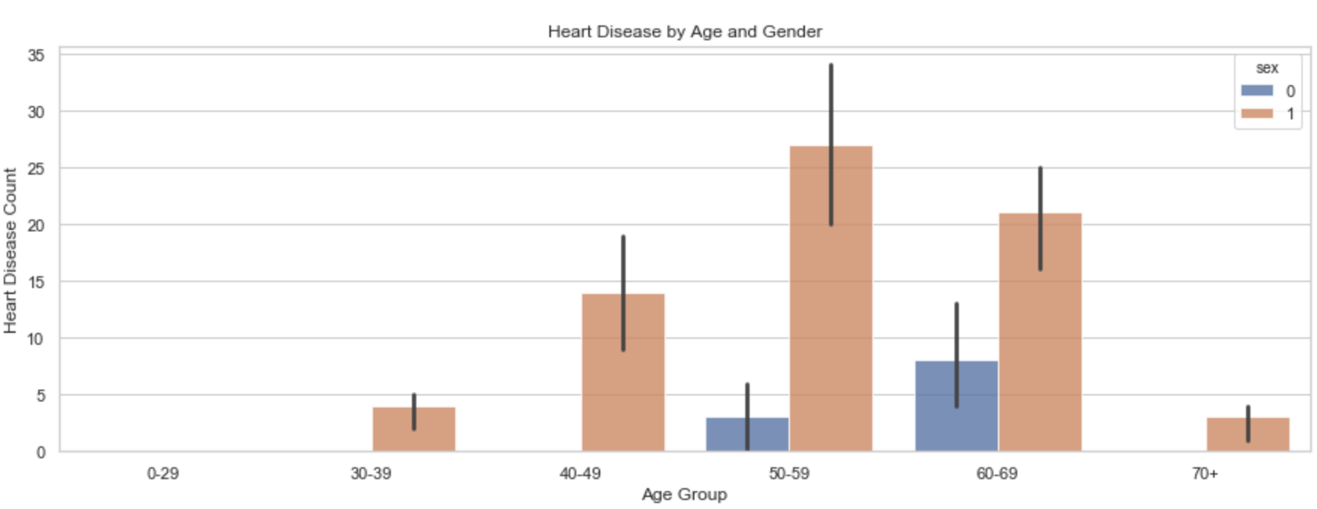
Method: Data Exploration
Female
Male
Notes:
From this chart, we can see that for age groups 40-49, 50-59 and 60-69 heart disease is more common than other age groups. We can also see that gender could be correlated with heart disease presence since males have a higher frequency.

Slide 9
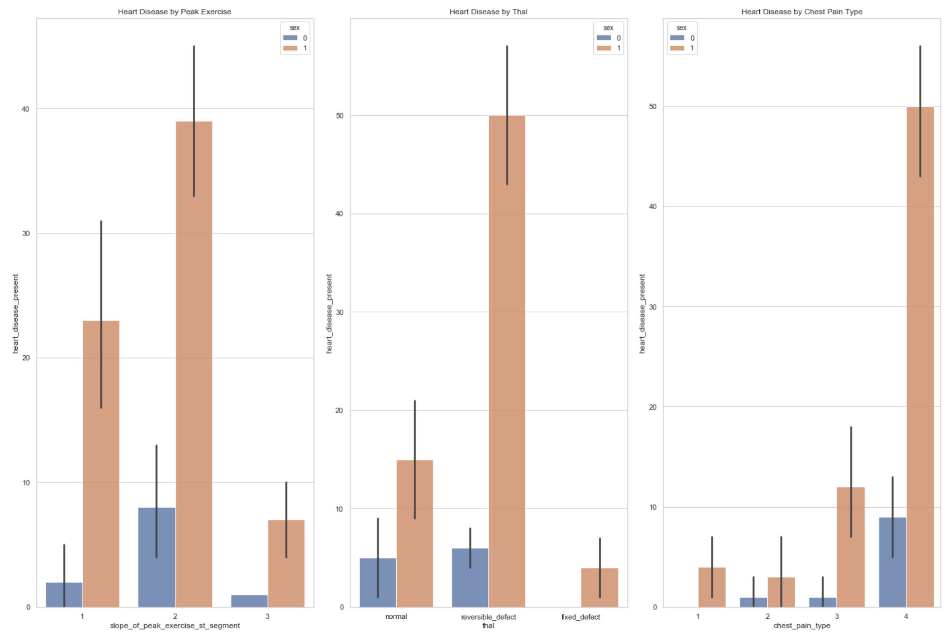
Method: Data Exploration
Heart Disease by
Peak Exercise ST Segment
Heart Disease by
Thal
Heart Disease by
Chest Pain Type
Heart disease present
Heart disease not present

Slide 10
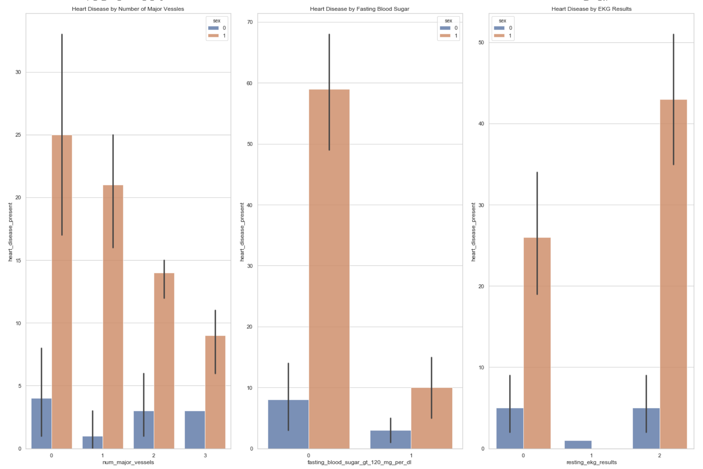
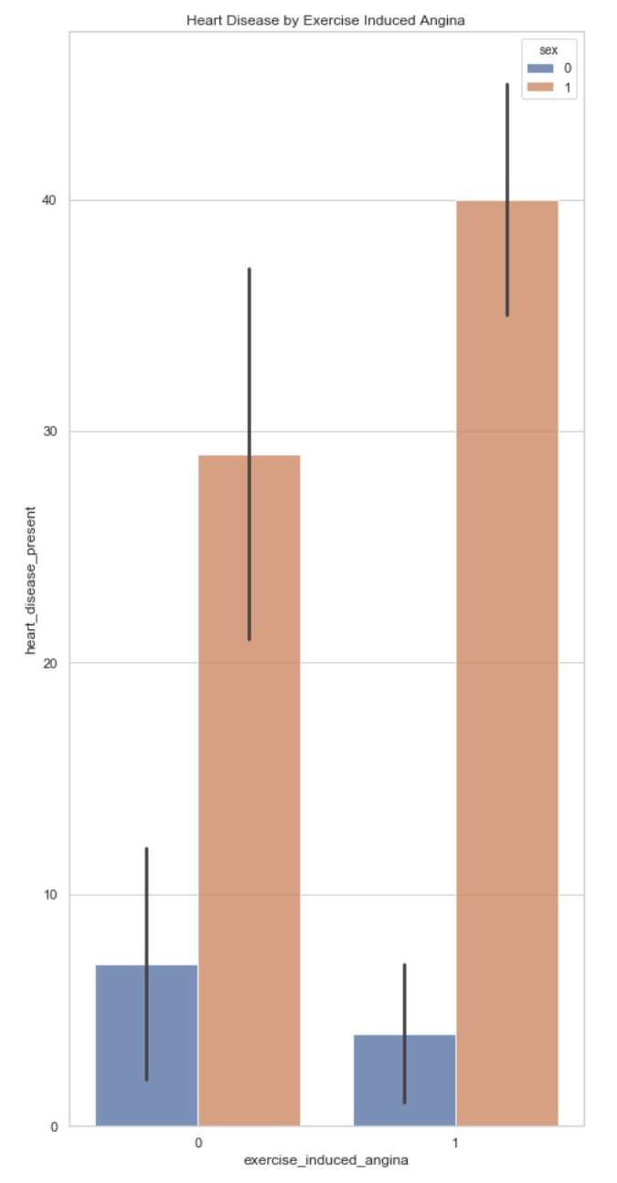
Method: Exploring the data
Heart Disease by
Number of Major Vessels
Heart Disease by
Fasting Blood Sugar
Heart Disease by
EKG Results
Heart Disease by
Exercise Induced Angina
Heart disease present
Heart disease not present

Slide 11
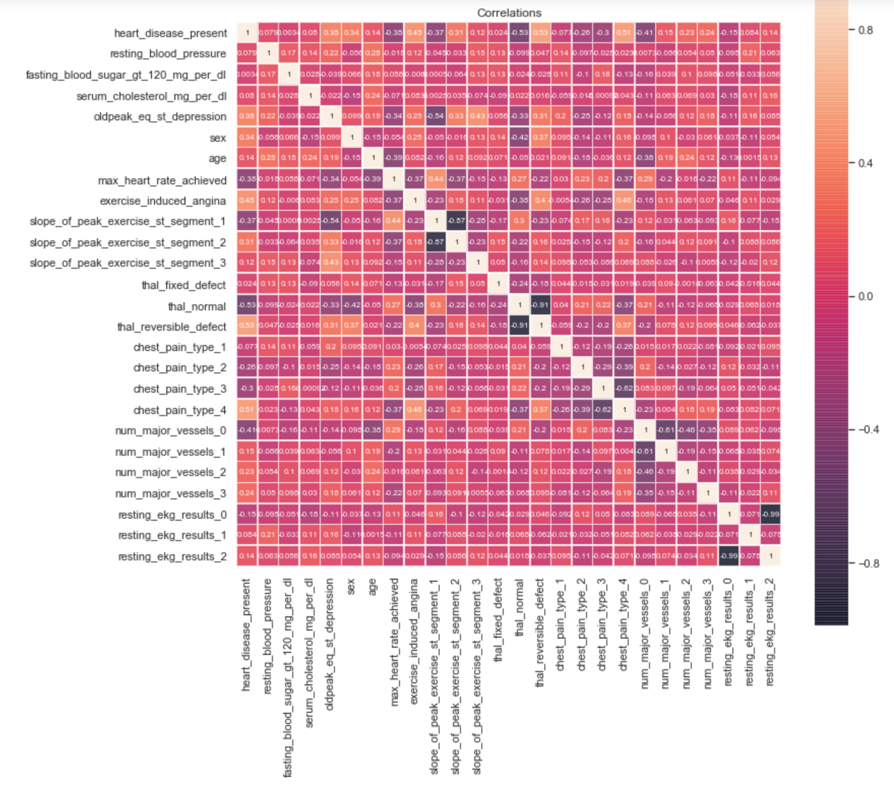
Method: Exploring the data Correlations
Notes:
From the Point-biserial correlation co-efficient , Max heart rate coefficient, oeak exercise, thal and chest pain are correlated with the presence of heart disease.

Slide 12
Method: Data Preparation
The following categorical features were binarized using get_dummies:
Slope of peak exercise
Thal
Chest pain type
Number of major vessels
Resting EKG results

Slide 13
Method: Modelling & Evaluation
Process
Outcome Variable:
Categorical
Data Splitting
Applying Classification Models
Model Tuning
Evaluation
Presence of Heart disease is indicated by binary (0,1)
Data sets are split into Train and Test Sets using train_test_split from sklearn.model_selection.
In order to predict heart disease, classification methods will be used
(Naive Bayes, Logistic Regression, KNN Classifier, Decision Tree, Random Forest, Bagging , Support Vector Models, Gradient Boosting Model, Ada Boosting and Stacking.
Each model requires different type of tuning.
To evaluate the performance of the different classifiers accuracy scores are used (metrics.accuracy_score), as well as classification reports (classification_report).
Notes:
The classification models used were starting from the simplest NB to most complex model Stacking.

Slide 14
Method: Naive Bayes
Data Set Features: mixed data types (categorical and continuous). The following process is applied:
  Data is divided according to data type.
  For categorical data, the Bernoulli model is used (BernoulliNB).
  For continuous data, the Gaussian model is used (GaussianNB).
    Features (Age, Max heart rate achieved, ST Depression, Resting blood pressure and Serum cholesterol) are normalized using .sqrt)
  The probabilities for outcomes from both models are added, averaged and binarized.
Notes:
Box Cox transformation is not used because the data contains some values that are close to 0.
Normality is assessed using jaque berra test

Slide 15
Method: Feature Engineering
Feature engineering:
Converted to dummy variables
Normalized data
Experimented with combining features
Feature Selection:
Feature selection tool from Gradient Boosting Model
KBest feature selection tool

Slide 16
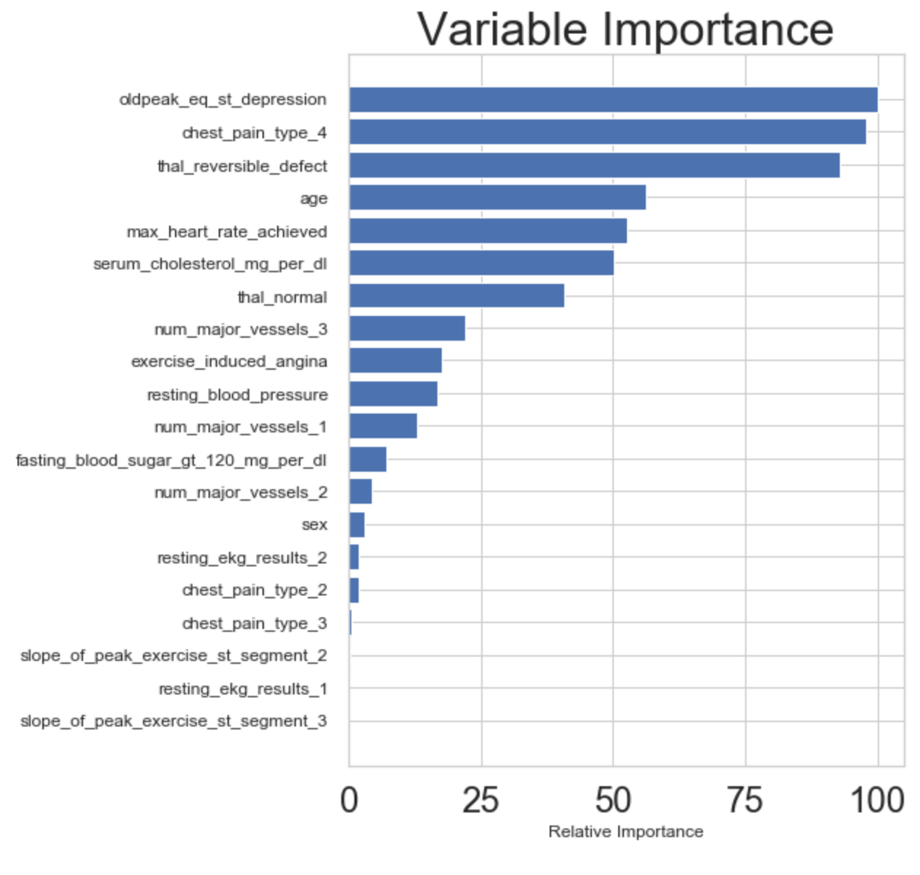
Method :Feature Selection (Gradient Boosting Model)
The outcome variable in this project is presence of heart disease. Relying on Feature Importance tool (Gradient Boosting Model), the features that determine the outcome are:
ST Depression
Chest Pain Type
Thal
Age
Max Heart Rate Achieved

Slide 17
Method: Feature Selection (Select K best )
Relying on Feature Importance tool (Gradient Boosting Model), the features that determine the outcome are:
Max Heart Rate Achieved
ST Depression
Exercise Induced Angina
Thal Reversible Defect
Chest Pain Type 4

Slide 18
Method: Model Tuning (Parameters)
Examples of tuning used in this project:
KNN:
  n= number of neighbors
  Weight by distance
Decision Tree:
  Number of max features
  Depth

Slide 19
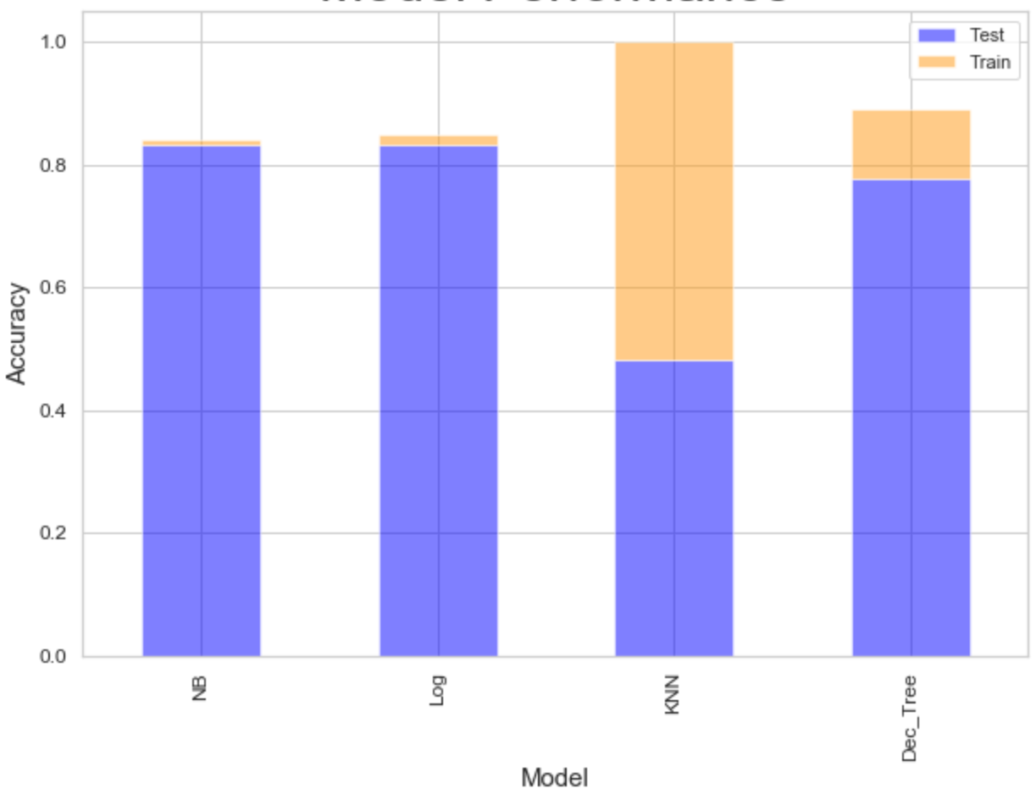
Evaluation: Individual Predictors Performance

Slide 20
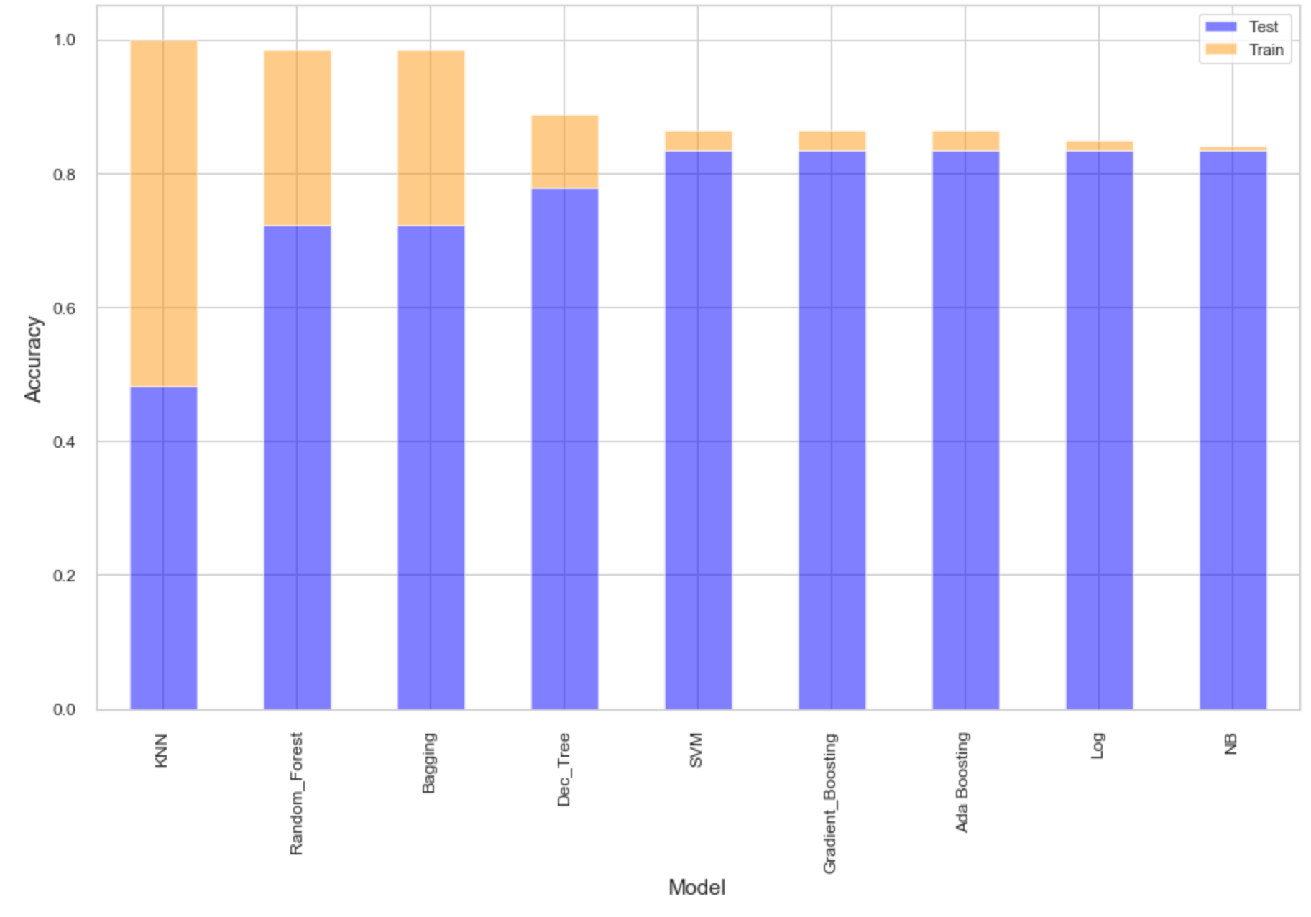
Evaluation: Ensemble Predictors Performance

Slide 21
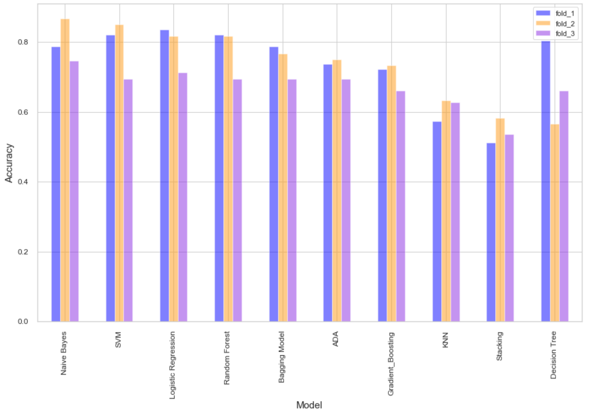
Evaluation: Ensemble Predictors Performance
Notes:
Adding stacking and using cross evaluation and accuracy score.

Slide 22
Conclusion
Relying on accuracy scores, NB performed the best in terms of generalization gap.
SVM performed the best out of ensemble models when using accuracy score and cross evaluation.
Next steps:
Invest more time on feature selection.
Invest more time on tuning.
Pipeline method to optimize code, tune parameters and try multiple functions.
Create two different models for males and females.

Slide 23
Limitations
Time
Dataset publicly available
Superficial knowledge of subject matter

Slide 24
Thanks!!
Questions?

Slide 25
NB
Correlations between key features are relatively low (>0.45).
Relationship between Outcome variable and key features is linear.

Slide 26
Rationale for choosing the models

